Slide 1
McKendree University Love You 5(K) Ever- Run & Walk

Slide 2
Cause
All earnings go to: Love You More Foundation
About: Love You More Foundation is a 501(c)(3) public charity that was established by Craig and Shelise Zurliene in honor and memory of their daughter, Bailey, who passed away from cancer in January 2016 at the age of 20. Love You More’s purpose is to provide assistance to persons and families affected by illness, to provide scholarships to high school and university students, to provide assistance to other organizations, businesses, schools, or persons through donations of money, service, time, and supplies, and to spread love and joy to those in need, while carrying on the legacy of Bailey.

Slide 3
Date, Start- and Runtime
Saturday, April 13th, 2024
Start: 8am, in front of Hettenhausen Center
End: 11am latest

Slide 4
Logistics
The Route is 3.1 miles long
We would not close off the streets
18-20 volunteers/workers to keep the runners safe
1 at each turn
2 at each intersection – especially at the main road

Slide 5
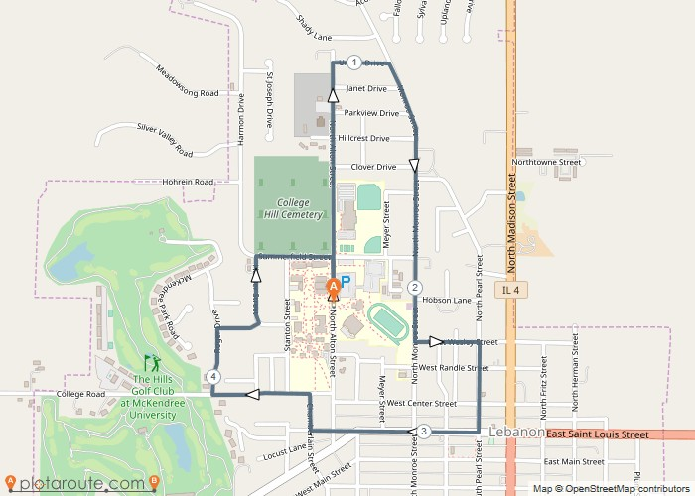
Race Route

Slide 6
Race details
Participants will run clockwise Starting in front of the Hett on the McKendree Campus
Runners will head North on N Alton St. to Ursula Drive and turn right onto Monroe St
Heading South on Monroe St past Leemon Field and turn left onto W Wesley St
Runners will then turn right onto Pearl St heading towards W St Louis St and take another right
Travel on west on W St louis St until you reach N Chamberlin St where they will turn right
Runners will travel on N Chamberlin St then take a left onto college Rd heading all the way to Roger Dr where they will then head right, then take another right once reaching Meril St
Once on Meril St runners will then turn left onto Hunter St until they reach Summerfield St where they will turn right
Once on Summerfield St they will turn right onto N Alton St for the final stretch of the race where it will conclude back at The Hett on McKendree’s campus

